Slide 1
PROFID (Post-MI) SCD risk Prediction Model
– Can it rise to the Challenge ?
대구가톨릭대학
순환기 내과
이 영 수

Slide 2
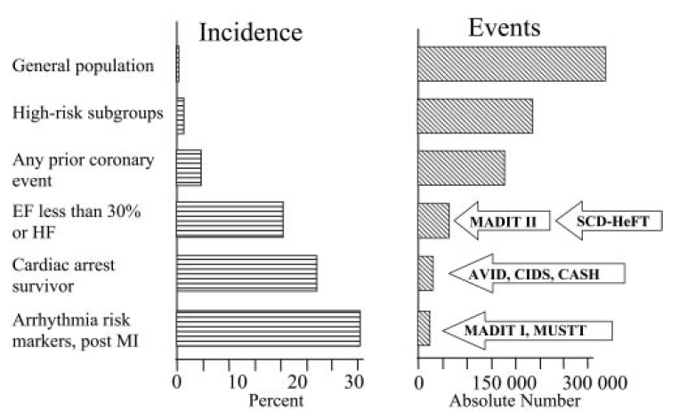
Sudden Cardiac Death

Slide 3
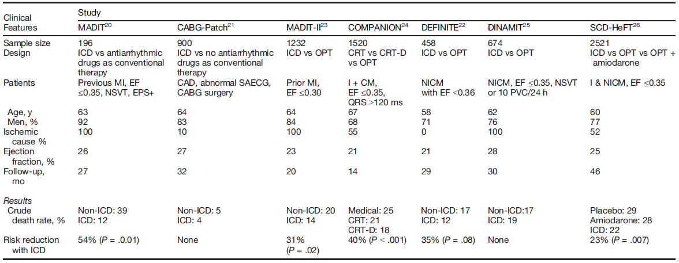
Primary prevention in ICM

Slide 4
MADIT (1990-1996)
Multicenter Automatic Defibrillator Implantation Trial
Inclusion
- MI for 3 weeks, EF < 35%,
Non-sustained VT, EPS +
NYHA Class I-III
Pt. No : 196
Ejection fraction : 26 %
Follow-up : 27 months
The New England Journal of Medicine 1996;335:1933-40

Slide 5
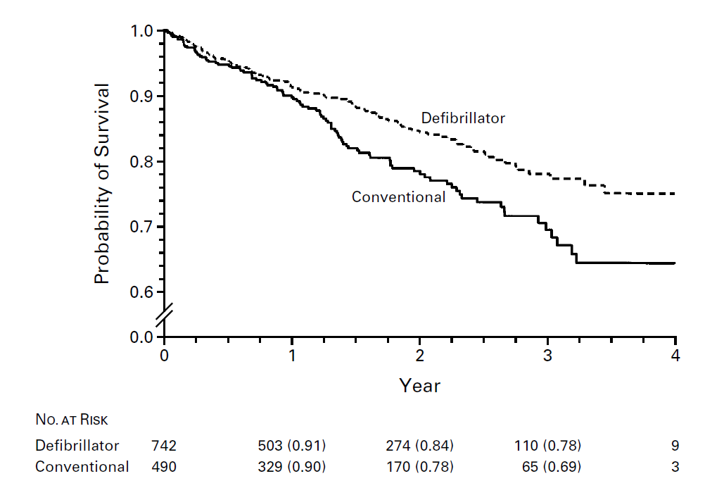
MADIT II (1997-2001)
Multicenter Automatic Defibrillator Implantation Trial II
Inclusion
- post MI patients with EF <30%
> 10 PVCs/hour
Pt. No : 1232
Design
: ICD or conventional - 3 : 2
Ejection fraction : 23 %
Follow-up : 20 months
RR 31%
p= 0.016
N Engl J Med 2002;346:877-883

Slide 6
Improved Stratification of Autonomic Regulation for risk prediction in post-infarction patients with preserved left ventricular function (ISA-Risk)
Inclusion
- post MI patients before 4wk
< 75 yrs
Pt. No : 2343
Autonomic marker
- HRT and Deceleration capacity
Follow-up : 5 yrs
European Heart Journal (2009) 30, 576–583

Slide 7
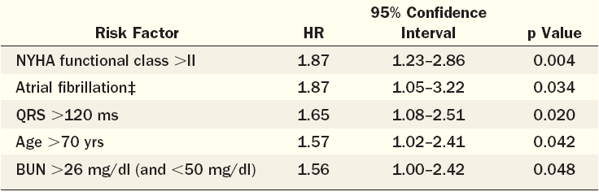
Risk Stratification for Primary of
ICD in Ischemic LV Dysfunction
From MADIT II
(J Am Coll Cardiol 2008;51:288–96

Slide 8
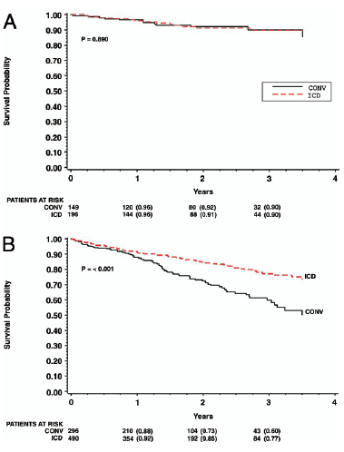
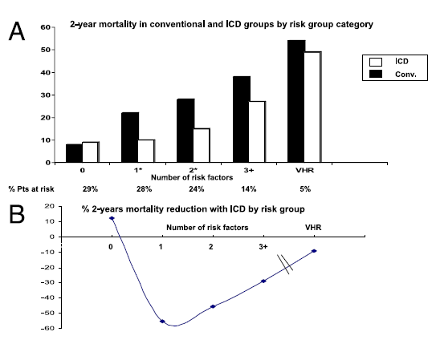
Risk of All-Cause Mortality in the
Conventional Therapy Group
Risk factor 0
Risk factor >0
J Am Coll Cardiol 2008;51:288–96

Slide 9
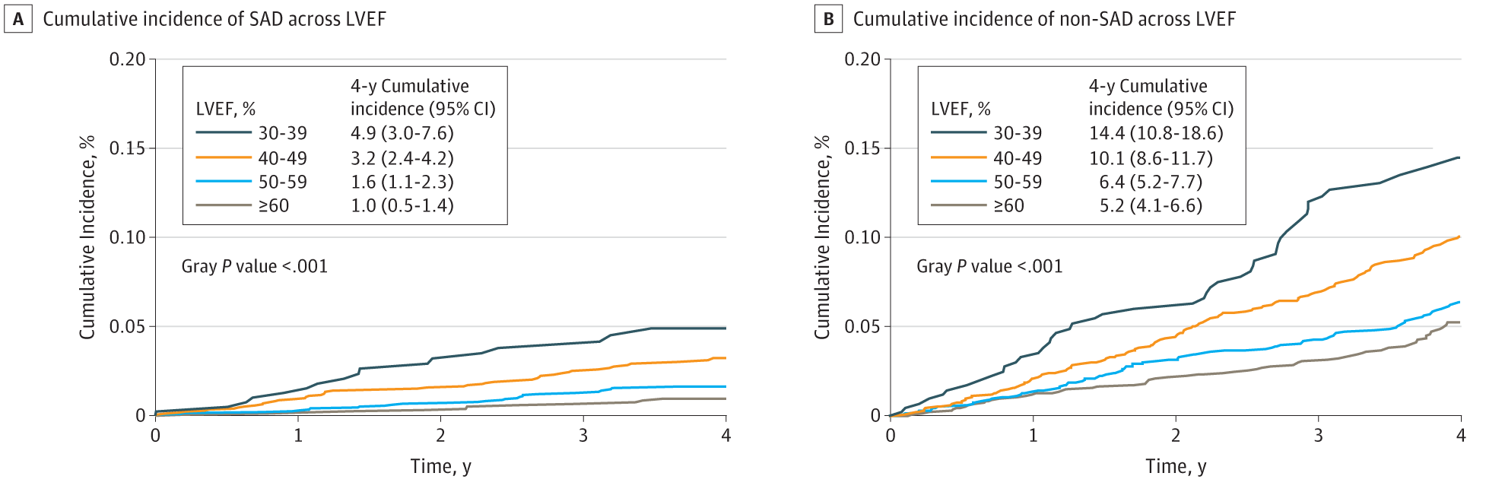
Sudden death in CAD
Inclusion : 5761 pts with Hx. of MI, EF > 30%
Follow-up : 4 yrs
Primary endpoint : sudden arrhythmic death
PRE-DETERMINE study, JAMA Cardiol. 2018;3(7):591-600.

Slide 10
Sudden death in preserved EF after AMI
Inclusion : 2130 pts with AMI
Follow-up : 1012 days
Holter monitoring : turbulence slope (TS)
European Heart Journal (2005) 26, 762–769

Slide 11
ISAR-Risk
Risk stratification by severe autonomic failure in pts with LVEF > 30%
All cause mortality (%)
Sudden cardiac death (%)
European Heart Journal (2009) 30, 576–583

Slide 12
Low rates of appropriated therapy
Inclusion
- pts with ICD/CRT-D for primary or secondary prevention of SCD
Pt. No : 2349 , Follow-up : 30 month
21%
9%
8.4%
3%
Israeli ICD registry, Heart Rhythm2015;12:2426–2433

Slide 13
Similar mortality irrespective to EF
Israeli ICD registry, Heart Rhythm2015;12:2426–2433

Slide 14
Limitations of LVEF as standalone risk stratifier
the majority of SCD cases occur in patients with preserved or moderately reduced LVEF.
only relatively few patients with reduced LVEF will benefit from an ICD (most will never experience
a threatening arrhythmic event, others have a high risk for non-sudden death).
(iii) a reduced LVEF is a risk factor for both sudden and non-sudden death.
Several other risk stratifiers, such as PVC, QRS duration, signal-averaged ECG, microvolt T-wave
alternans, markers of autonomic tone, and programmed ventricular stimulation, have been evaluated.
European Heart Journal (2013) 34, 1964–1971

Slide 15
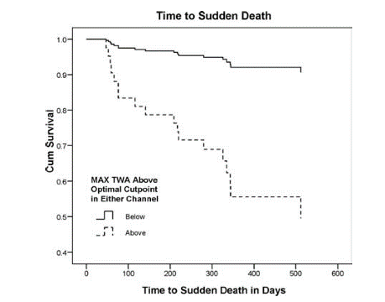
T-Wave Alternans in Post MI
EPHESUS Study (n=493)
Post-MI day 2~10
TWA (Ambulatory ECG-based)
500 days f/u
< 43μV (V₁) and < 47μV (V₃)
≥ 43μV (V₁) or ≥ 47μV (V₃)
J Cardiovasc Electrophysiol, 2008; 19: 1037-1042

Slide 16
Heart Rate Turbulence in Post MI
HRT 0 : Both Normal group (both T Onset and T Slope were normal)
HRT 1 : Either Abnormal group (either T Onset and T Slope was abnormal)
HRT 2 : Both Abnormal group (both T Onset and T Slope were abnormal)
J Am Coll Cardiol 2008;52:1353–65

Slide 17
Heart rate variability in Acute MI
312 AMI Pts
with low EF (31%)
Primary endpoint
: Cardiac arrhythmia
FU 2 Yr
CARISMA study. EHJ (2009) 30, 689–698

Slide 18
Heart rate variability in Acute MI
138 AMI Pts With EF ≥ 35% received 24hr Holter
Primary endpoint : Sudden cardiac arrhythmia (VF/VT)
FU : 24 month
HR 8.888
(1.871-42.220)
P=0.013
HR 14.699
(1.653-130.691)
P=0.012
CARISMA study. EHJ (2009) 30, 689–698

Slide 19
1. Development of a clinical prediction model for the assessment of the individual risk for SCD
2. The proof of the utility of this prediction model in clinical practice
• The PROFID-Reduced trial in patients with EF ≤ 35% but a low predicted
individual risk for SCD that will be randomized to ICD vs. no-ICD in a non-inferiority
design.
• PROFID-Preserved in patients with EF>35% and a high predicted individual risk for
SCD that will be randomized to ICD vs. no-ICD in a superiority design.

Slide 21
Summary
European Heart Journal (2013) 34, 1964–1971

Slide 22

Thanks for your attention

